Slide 1
Early-Stage Diabetes Risk Test WebApp
2022
# PIC16B
Group Member:
Yiran Liu
Zhuofan Huang
Jiyuan Lyu
Notes:
Hi, everyone. My name is Zhuofan Huang, and my teammates are Yiran Liu and Jiyuan Lyu. Because one of my group member can’t make it in-person, we decided to record our presentation through zoom. Our group project is a Diabetes Risk Test Webapp.

Slide 2
Table of contents
1. Introduction
2. Machine Learning (Yiran Liu)
3. Webapp Development (Jiyuan & Zhuofan)
4. Limitation
5. Reference
PIC 16B - Final Project
Notes:
Here’s the table of contents. In this project, my teammate Yiran will be mainly in charge of Machine Learning part. And Jiyuan and me will be in charge of Webapp development.

Slide 3
.21
Contents of this template
Part I
Introduction
Notes:
Now, let’s move on to the introduction part.

Slide 4
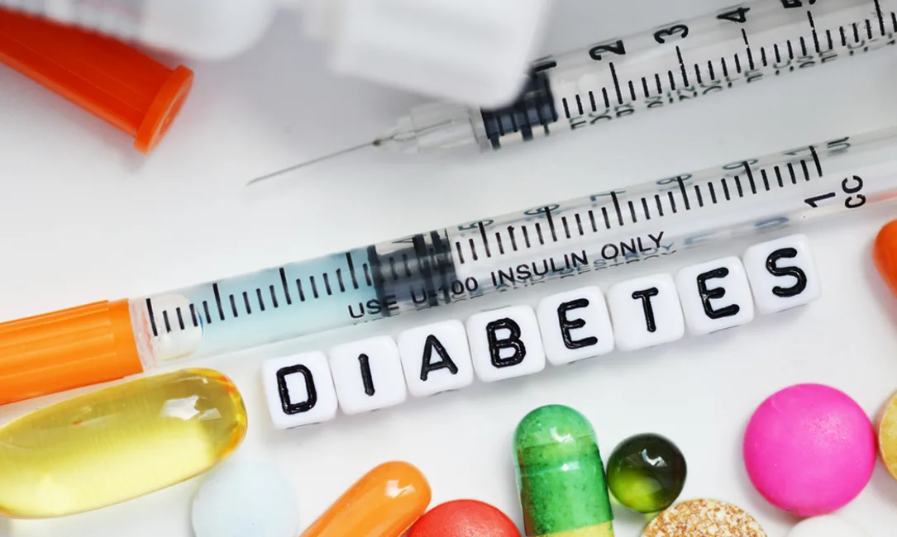
What is Diabetes?
Diabetes is a chronic disease that occurs when the pancreas is no longer able to produce insulin or when the body cannot make full use of the insulin it produces. In this case, our body’s blood sugar will rise, which will lead to a chronic damage dysfunction of various tissues, especially the eyes, kidneys, heart, blood vessels, and nerves.
Notes:
What is Diabetes? Diabetes is a chronic disease that occurs when the pancreas[ˈpæŋkriəs] is no longer able to produce insulin[ˈɪnsəlɪn] or when the body cannot make full use of the insulin[ˈɪnsəlɪn] it produces. In this case, our body’s blood sugar will rise, which will lead to a chronic damage dysfunction[dɪsˈfʌŋkʃn] of various tissues, especially the eyes, kidneys, heart, blood vessels, and nerves.

Slide 5
.21
Introduction
To The Project
Contents of this template
Purpose
Provide Result Based On Trained Model
Data Resources
The Target Population: Patients and Hospital
Notes:
The purpose of this project is to create a Web App where people can predict whether they are at risk for diabetes based on few questions that they answered. The result will be based on our pre-trained model using Machine Learning algorithms.
Our dataset is from UCI Machine Learning Repository, which has been collected using direct questionnaires from the patients of Diabetes Hospital in Bangladesh[ˌbæŋɡləˈdeʃ], and approved by a doctor.
If the result of the Diabetes Risk Test indicates the risk of diabetes, we will recommend the respondent to visit a hospital for professional examinations.

Slide 6
Part II
Table of contents
PIC 16B - Final Project
Machine Learning
Notes:
Then, let’s move on to part 2, machine learning.

Slide 7
.1
Data
Cleaning
.2
Full
Model
.3
Feature Selection
.4
New Model
PIC 16B - Final Project
Notes:
Zhuofan: Our machine learning part will follow the above guideline. First, we clean the dataset to make sure we’ve successfully clean all the unusual or missing values. Secondly, we trained our full models using all features from the data set, and we report the validation accuracy for each machine learning algorithms. Thirdly, we performed feature selections by using correlation plot and found the most significant and important features. Lastly, we train our model again using the best features we’ve selected.

Slide 8
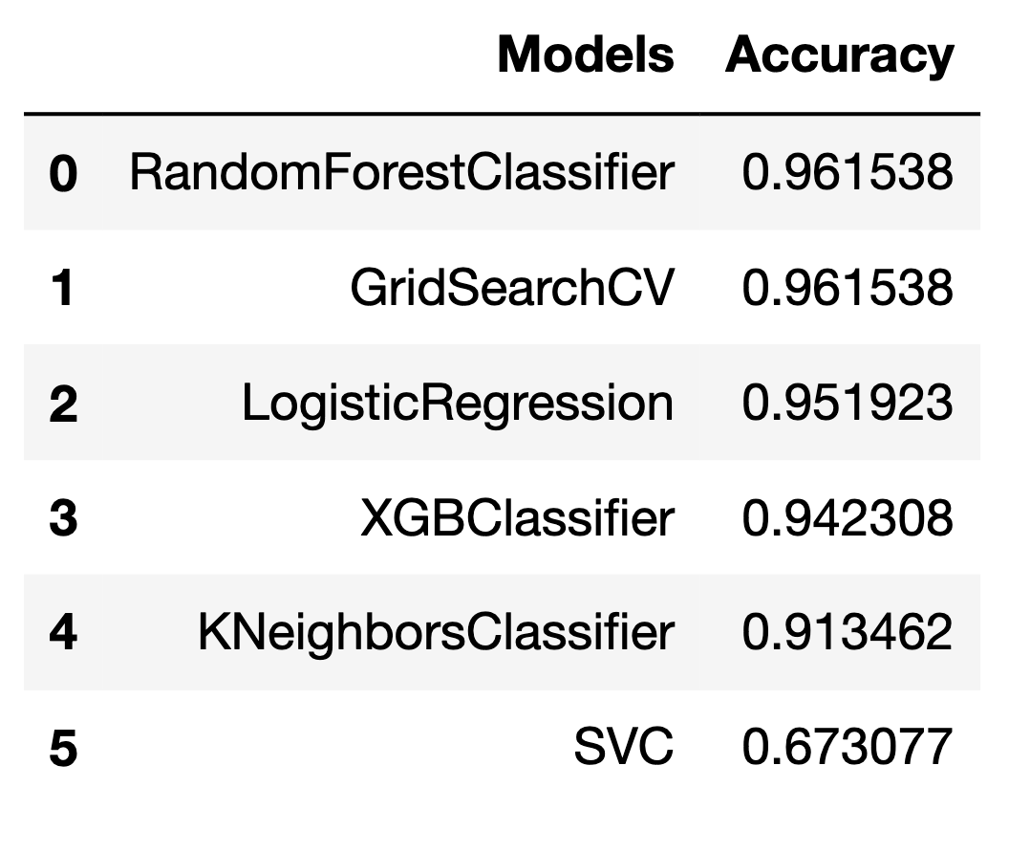
Full Model
We trained our model using all features of the dataset.
Machine Learning algorithms including:
Random Forest
GridSearchCV
Logistic Regression
XgBoost
KNN
Support Vector Machine
Notes:
Our team member Yiran mainly accomplished the modeling part. I’ll be introducing what he have done in this part. For the full model, we trained our models using all the features in the dataset. The ML algorithms we’ve tried includes Random Forest, GridSearchCV, Logistic Regression, XgBoost, and KNN, Support Vector Machine. We reached the highest accuracy of 96% by using Random Forest.

Slide 9
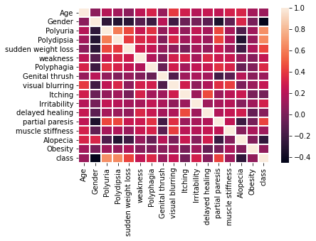
Feature
Selection
The Top 10 Significant Features:
Gender 0.449233
Polyuria 0.665922
Polydipsia 0.648734
sudden weight loss 0.436568
weakness 0.243275
Polyphagia 0.342504
visual blurring 0.251300
Irritability 0.299467
partial paresis 0.432288
Alopecia 0.267512
Correlation Plot
Notes:
In order to achieve a higher accuracy, we perform a feature selection. By plotting the correlation matrix plot, we found the most significant quantitative features to build the model. These features are shown in the slide. In the next step, we’ll use these features to build our new predicting model.

Slide 10
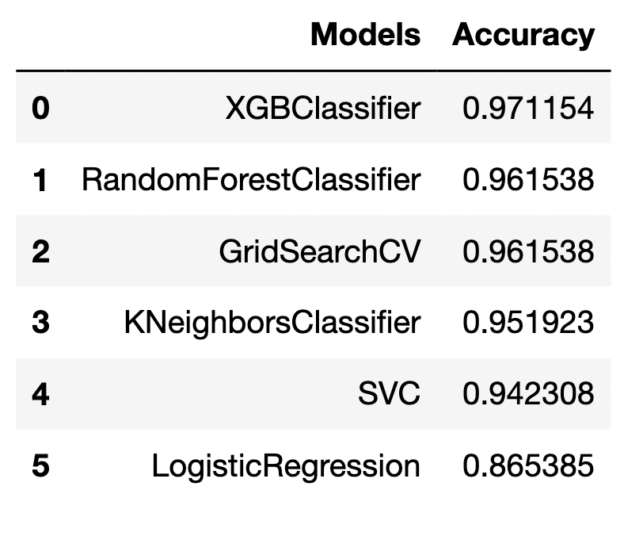
New
Model
Train our new model using new features from feature selection.
The highest validation accuracy score reached 97.12%!!! (XgBoost)
Notes:
So, for our new model, we will use the features we’ve selected from the feature selection part. And we report the accuracy scores again. This time we reached the highest accuracy score of 97% by using XG-Boost algorithm.

Slide 11
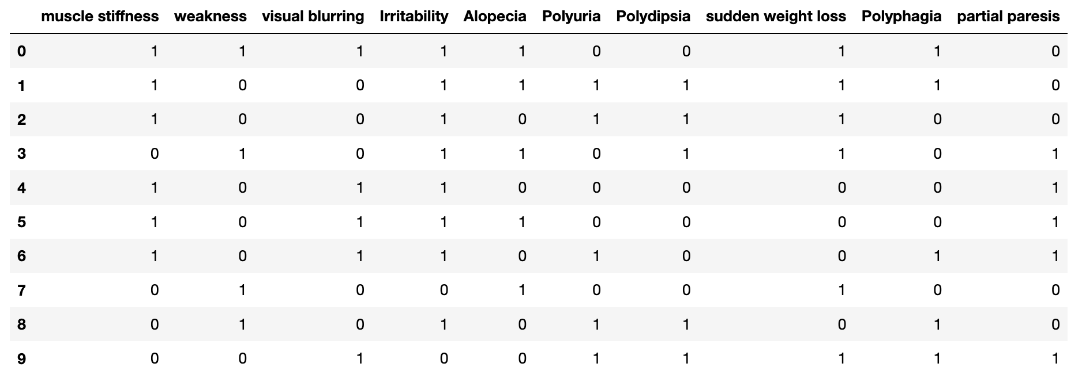
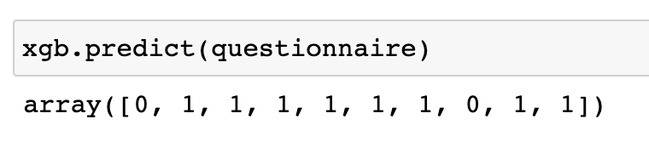
Simulation
Assume 10 users have finished the questionnaire. Let’s see what the model predict
Predicting the result
Notes:
Now, Let’s simulate how our model works in the web app. suppose 10 people have finished the test. The data that these 10 people answered will be predicted by our xgboost model. After we got the result, respondent can click a button to view their result.

Slide 12
Part III
Web Development
PIC 16B - Final Project
Notes:
Hi, I’m Jiyuan Lyu. Then, our next part would be Webapp development.

Slide 13
Flask Webapp
PIC 16B - Final Project
1. Initialize Flask Webapp Environment
2. Create Web page templates (Base, Submit, View)
3. Database to store the information and results
4. CSS Stylesheet
Notes:
In this project, we will utilize Flask to create the webapp. First, we initialize our webapp environment by installing Flask, and some related packages such as sqlite3. Secondly, we wrote three templates: base, submit, and view. Thirdly, we write python code in the webapp to create database to store the information and questionnaire results. Finally, we modified the CSS stylesheet to make our webapp looks better.

Slide 14
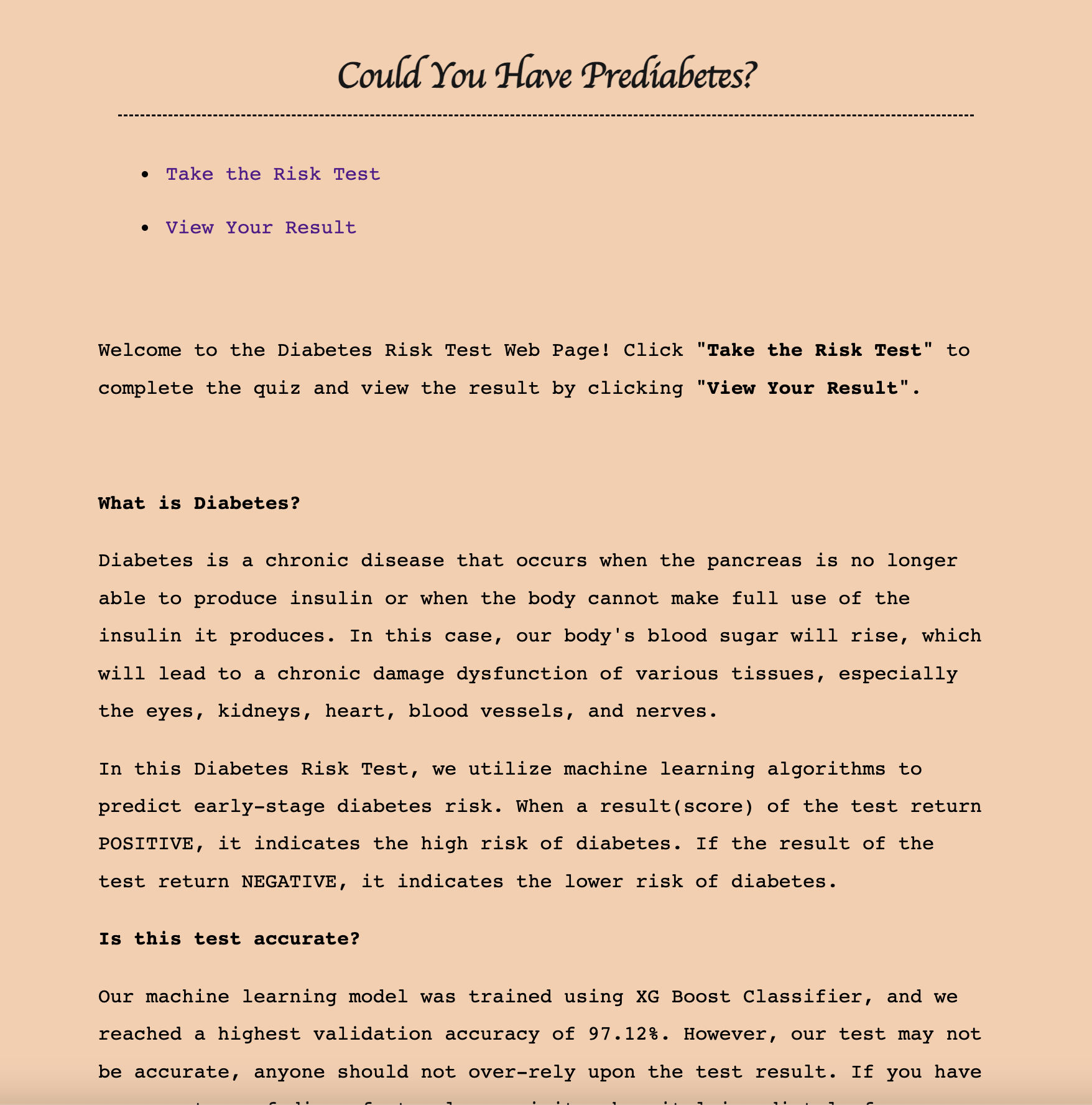
How does the web app look like?
base.html
Notes:
After we’ve done everything for the webapp, our webapp home page look like this.

Slide 15
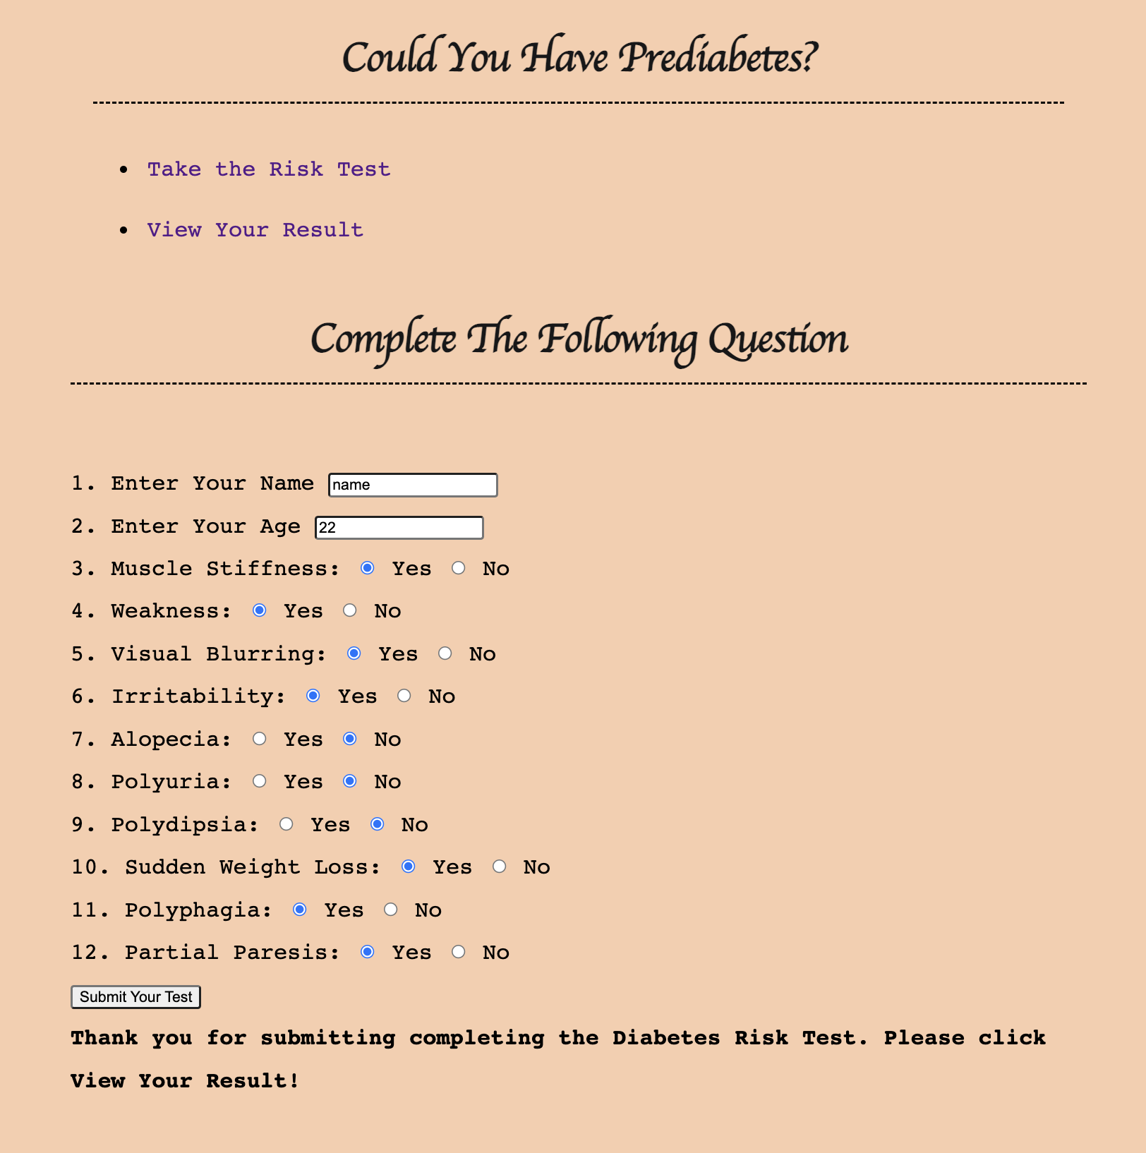
How does the web app look like?
submit.html
Notes:
Then, If you click the “Take the Risk Test” button, the webapp will navigate to the submit template. It will ask you to answer some questions. After you’ve completed the questionnaire, click Submit your test button.

Slide 16
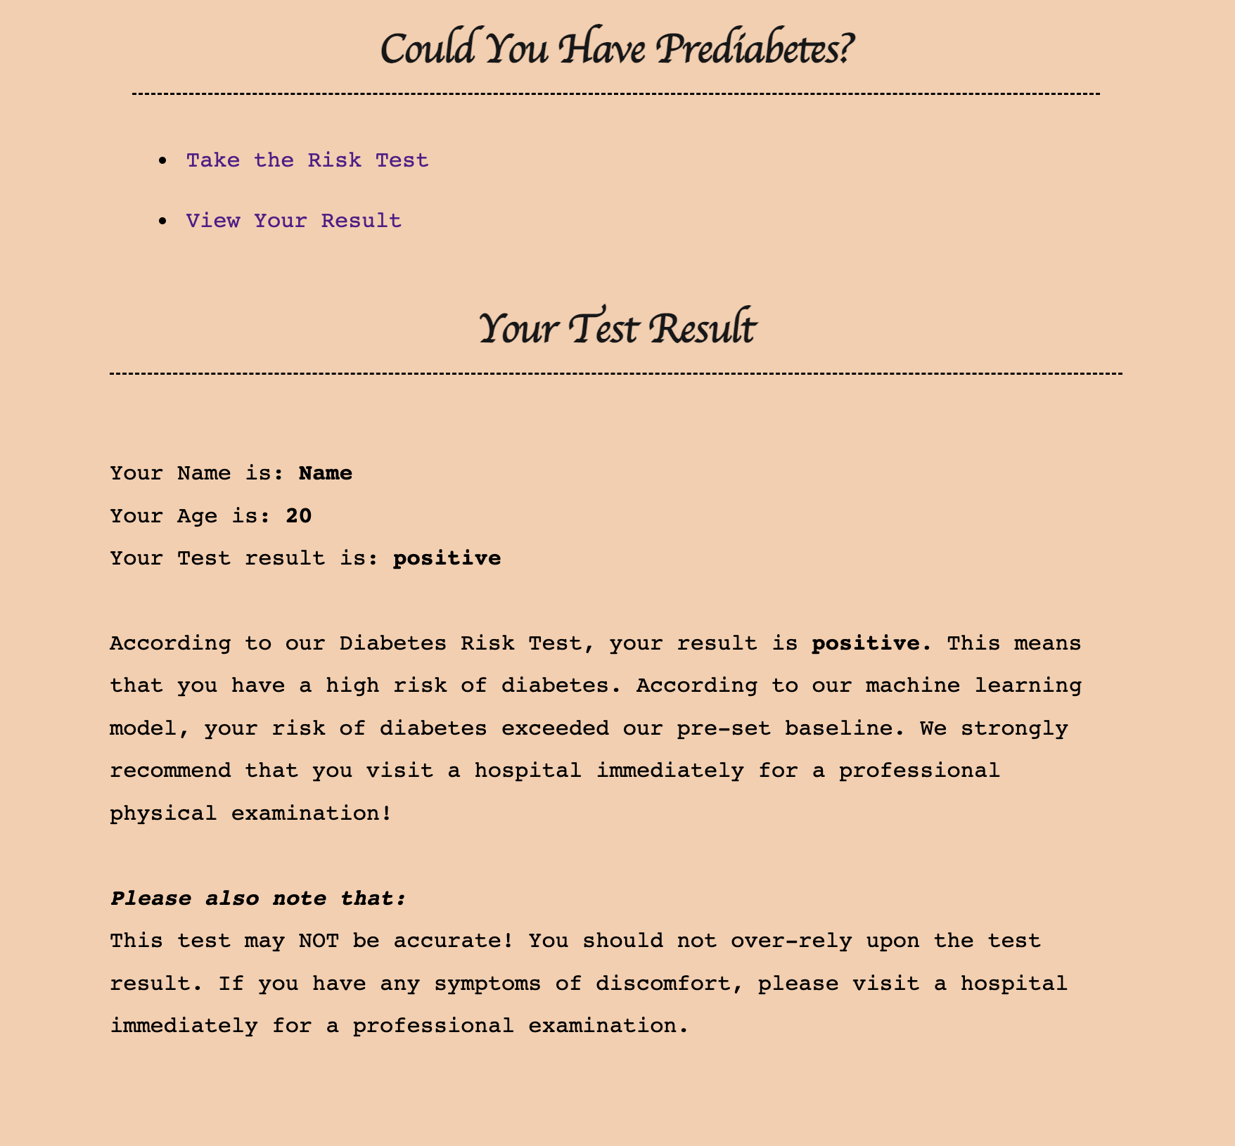
How does the web app look like?
view.html
Notes:
Then, we click View Your Result to see the suggestion. If the test result is positive, we will recommend the respondent to visit a hospital immediately.

Slide 17
Limitation
The accuracy of machine learning predictions usually depends on the accuracy of the data it uses to learn. Early symptoms of diabetes vary from person to person and may be different for each individual, so we highly recommended that anyone who feels abnormal go to the hospital immediately for a more specialized examination.
Notes:
There are also some limitations in our project. The accuracy of machine learning predictions usually depends on the accuracy of the data it uses to learn. Early symptoms of diabetes vary from person to person and may be different for each individual, so we highly recommend that anyone who feels abnormal go to the hospital immediately for a professional examination.

Slide 18
Reference
Data Set:
Early stage diabetes risk prediction dataset from UCI Machine Learning Repository (https://archive.ics.uci.edu/ml/datasets/Early+stage+diabetes+risk+prediction+dataset.#)
What is Diabetes? (https://www.cdc.gov/diabetes/basics/diabetes.html)
Notes:
Finally, here’s the reference of our project.

Slide 19
Thank you!
Notes:
Thank you!

